Slide 1
Build Migration Plan

Slide 2
Outline
Objectives: What were the original project goals?
Findings: What insights did we find and how did we find them?
Next steps: What are the recommendations for next steps?

Slide 3
Objectives
Recall that the migration planning assessment set out to answer three questions
1
What are ripe targets for lift and shift to Azure IaaS?
2
What are the costs to migrate and run the targets on Azure?
3
What are the tactical next steps to achieve the opportunities?
$
Next Steps

Slide 4
Outline
Objectives: What were the original project goals?
Findings: What insights did we find and how did we find them?
Next steps: What are the recommendations for next steps?

Slide 5
Methodology
After scanning the XX node environment, we applied hypotheses and technical analysis to funnel down to a subset of ripe migration targets
1
Addressable Nodes
Addressable Azure Spend
Inventoried global IT estate with the Cloudamize tool.
Americas, Europe, Asia
XX
$XX
Focus Area Hypotheses
Technical
Evaluation
2
Formed hypotheses about where the “quick win” migration targets exist
Focus Areas
XX
$XX
3
Leveraged Cloudamize tool to plan cloud migration
analyzed dependencies
performed Azure hardware mappings
forecasted Azure costs
a
b
Migration Targets
XX
$XX¹
c
1 – Azure cost forecast includes savings from scheduled turn off/turn on of appropriate low utilization targets

Slide 6
Hypotheses
2
We prioritized where to conduct deep technical analysis
1
Sensitive Workloads: Avoid [fill…] due to customer privacy issues
Geos: Focus on [fill…] discussed geo as a starting point
Environments: Prioritize Development and Staging; Disaster Recovery is another potential opportunity
End of Life: Migrating end of life hardware to Azure is preferable to refreshing
Turn Off Candidates: A number of machines potentially have low utilization
Resource Constraint: Factor in any resource or budget constraints. [fill…]
2
3
4
5
6

Slide 7
Dependencies
3
a
Cloudamize facilitated grouping of infrastructure into “move groups” according
to workload dependencies
On-Premise Inventory Map

Slide 8
Dependencies
3
a
Cloudamize facilitated grouping of infrastructure into “move groups” according
to workload dependencies
On-Premise Inventory & Dependencies Map

Slide 9
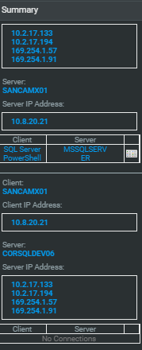
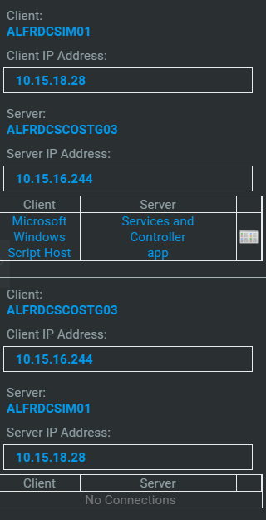
Dependencies
3
a
Cloudamize facilitated grouping of infrastructure into “move groups” according
to workload dependencies
On-Premise Inventory & Dependencies Map
Critical: SQL Server Dependency
Non-Critical: Admin Script Dependency

Slide 10
Azure Hardware Mappings
3
b
Next, the optimal Azure targets were selected through “right sizing” logic
On-Premise Move Group
Azure Instances
?
?
?
?
?
?

Slide 11
Azure Hardware Mappings
3
b
Next, the optimal Azure targets were selected through “right sizing” logic
On-Premise Move Group
Azure Instances
Cloudamize Algorithm
A1
A3
A3
A2
D3 v2
D1 v2
Baseline on-prem infra specifications:
Performance metrics, such as CPU, memory, Disk IO, network
Utilization
Select the “right sized” Azure machines that minimize costs while ensuring performance

Slide 12
Azure Costing
3
c
Finally, we ran usage and pricing scenarios to measure future Azure costs
Annual
Hours
Needed
Cost per Hour ($)
Annual Costs
X
=
A1
A3
A3
A2
D3 v2
D1 v2
Annual costs forecasts include compute + storage + networking. Costs reflect right sizing and scheduled turnoff on weeknights and weekends for select candidates. Network costs assume that all observed network traffic was egress traffic.

Slide 13
Outcomes
We prioritized 5 “quick win” opportunities
1
What are ripe targets for lift and shift to Azure IaaS?
2
What are the costs to migrate and run the targets on Azure?
3
What are the tactical next steps to achieve the opportunities?
Development (XX nodes)
Staging (XX nodes)
End of Life (XX nodes)
Low utilization (XX nodes)
Low cost nodes (XX nodes)
Initiate migration of Development nodes
Implement turn on/turn off schedule recommendations
Schedule migration for remaining opportunities identified in this engagement
Plan additional analysis to identify next wave of IaaS and/or PaaS opportunities
Azure TCO:
$XX
Services:
$XX
$XX
XX

Slide 14
Outline
Objectives: What were the original project goals?
Findings: What insights did we find and how did we find them?
Next steps: What are the recommendations for next steps?

Slide 15
Next Steps Highlights
We recommend initiating the migration of the Development environment
1
Initiate migration of Development environment (Timeframe: ---)
# of nodes
Amount: $XX
Introduce turn off/on schedule on-premise
Schedule automatic turn on/turn off for low utilization candidates in preparation for cloud IT operations model
Execute remaining “Quick Wins” IaaS migration opportunities (Timeframe: ---)
Schedule internal migration project for remaining opportunities identified through this engagement
Additional IaaS and PaaS opportunities may exist
Plan additional migration assessments
Plan additional analyses to identify the next wave of IaaS and/or PaaS opportunities
2
3
4

Slide 16
Sample Project Plan Timeline
Start Time
Nov
Dec
Jan ‘17
Feb
Mar
Apr
May
Jun
Jul
Aug
Sept
Oct
Nov

